Slide 1




















El Verbo “GUSTAR”
En español gustar significa “to be pleasing”
In English, the equivalent is “to like”
Spanish One ch.1

Slide 2

Por ejemplo:
In English we say: “I like Spanish.”
En español decimos: “To me, Spanish
        is pleasing.”

Slide 3
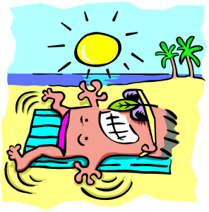
I like the beach.
In English:
“I” is the subject
“like” is the verb
“the beach” is the direct object
En español:
“the beach” is the subject
“to please” is the verb
“me” is the indirect object

Slide 4
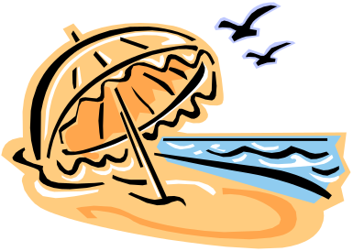
En Español…:
The word order is actually “backwards”:
The indirect object comes first: Me
Then the verb: gusta
Finally the subject of the verb: la playa.
Make it negative by adding “no” at the beginning.

Slide 5
Four Keys Things that are different with Gustar
It only has two conjugations:
  a. gusta
  b. gustan

Slide 6
Four Keys Things that are different with Gustar
1.It only has two conjugations:
2.It is conjugated based on what comes after it.

Slide 7

“Gusta” = singular nouns = infinitives
“Gustan” = plural nouns
= two or more
singular nouns

Slide 8
Four Keys Things that are different with Gustar
1.It only has two conjugations:
2.It is conjugated based on what comes after it.
3. It always uses an Indirect Object Pronoun.

Slide 9
Who is doing the “liking”?
Indirect Object Pronouns:
me
te
le
nos
--
les

Slide 10
Me gusta… / Me gustan…
Te gusta… / Te gustan…
Le gusta… / Le gustan…
Nos gusta… / Nos gustan…
--------------------
Les gusta… / Les gustan…
I like…
You like…
He / she / You like(s)…
We like…
-----------------
They / you all like…
=

Slide 11
Four Keys Things that are different with Gustar
1.It only has two conjugations:
2.It is conjugated based on what comes after it.
3. It always uses an Indirect Object Pronoun.
4. It may also use an I.O. clarifier.

Slide 12
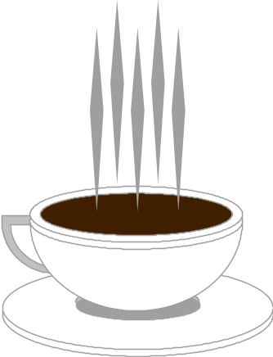
¿Cómo se dice?
“I like coffee.”
Me
gusta
el café.
“Coffee is pleasing to me.”

Slide 13
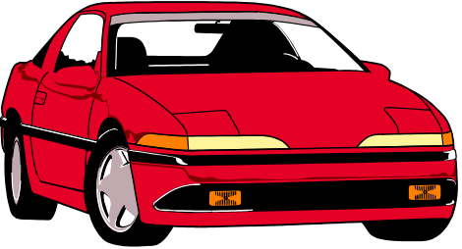
¿Cómo se dice?
“You like cars.”
Te
gustan
los coches.
“Cars are pleasing to you.”

Slide 14
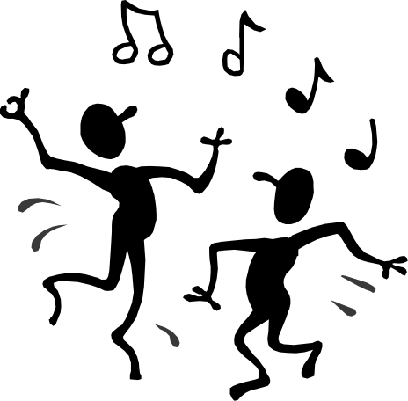
¿Cómo se dice?
“He doesn’t like to dance.”
No le
gusta
bailar.
“To dance is not pleasing to him.”

Slide 15
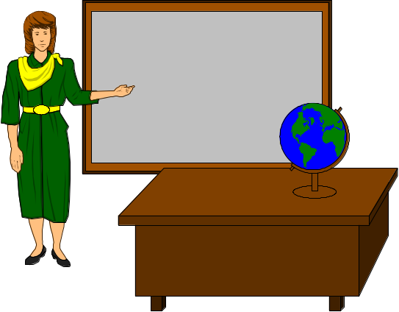
¿Cómo se dice?
“We like our teachers.”
nuestros profesores.
Nos
gustan
“Our teachers please us.”

Slide 16

¿Cómo se dice?
“You (all) don’t like to go to the movies.”
No les
gusta
ir al cine.
“To go to the movies is not pleasing to you (all).”

Slide 17

¿Cómo se dice?
“They like history and spanish.”
la historia y el español.
Les
gustan
“History and Spanish are pleasing to them.”

Slide 18
¿Cómo se dice en español?
I like to study.
Elena likes to watch television.
We don’t like to do homework.
Carlos and Miguel like cars.
Do you all like to look at photos?
You like to go shopping, right?
Me gusta estudiar.
(A Elena) le gusta ver la televisión.
No nos gusta hacer la tarea.
(A Carlos y a Miguel) les gustan los coches.
¿Les gusta mirar fotos?
Te gusta ir de compras, ¿verdad?

